Slide 1
Prediction of Diabetic Retinopathy based on Efficient Net
Presented By,
RAGUVARAN V (810017205066)
VIGNESH K (810017205093)
Under the Guidance of ,
Dr.S.Sathiya Devi,
Assistant Professor,
Department of Information Technology

Slide 2
Agenta:
Objective
Literature survey
Flow Diagram
Software and Hardware Requirements
Modules
Dataset description
Methodology / Algorithm / Procedure
Project planning
References

Slide 3
OBJECTIVE :
To Identify the Risk level of Diabetic Retinopathy by using Efficient Net.

Slide 4
LITERATURE SURVEY :
Name of the Author | Content | Techniques used | Merits/ Demerits | Dataset used
M. Mateen et. al. [1] | Exudate Detection for Diabetic Retinopathy Using Pretrained Convolutional Neural Networks | Transfer learning is performed for feature extraction using pre trained CNN models (Inception-v3, Residual Network-50 and Visual Geometry Group Network-19) | Gives good accuracy This framework cannot modified to discriminate hard and soft exudates | E-optho dataset [2] DIARETDB1 dataset [3]

Slide 5
Contd..
Name of the Author | Content | Techniques used | Merits/ Demerits | Dataset used
B.Tymchen ko et. al.[4] | Deep Learning Approach to Diabetic Retinopathy Detection | The multistage approach to transfer learning, A screening method for early detection of diabetic retinopathy | High and stable result even with unstable metric Encoders won’t be applied for all connected networks | Kaggle DRDC-2015 [5]

Slide 6
Contd..
Name of the Author | Content | Techniques used | Merits/ Demerits | Dataset used
M. Ahtazaz Ahsan et. al.[6] | An Active Learning Method for Diabetic Retinopathy Classiﬁcation with Uncertainty Quantiﬁcation | Bayesian convolutional neural network (BCNN) Active Learning | Less number of data sufficient to train the model Complexity of the model is challenging issue | APTOS-2019 [7]

Slide 7
Contd..
Name of the Author | Content | Techniques Used | Merits/ Demerits | Dataset Used
M.Tsighe Hagos et al. [8] | Transfer Learning based Detection of Diabetic Retinopathy from Small Dataset | transfer learning on a deep CNN model(Image net) Support Vector Machine(SVM) Cosine Loss function Optimization- SGD | Performs well on unseen data Won't be compared with any other model | DIARETDB1 Dataset [2]

Slide 8
Contd..
Name of the Author | Content | Techniques Used | Merits/ Demerits | Dataset Used
Mingxing Tan et al.[9] | Efficient Net: Improving Accuracy and Efficiency through AutoML and Model Scaling | Compound scaling | Smaller in size Better accuracy then other nets Better efficiency | CIFAR-100, Flowers

Slide 9
Flow Diagram :
Data storage
Data loading
Pre Process
Classification & performance Evaluation
Data preparation
Predicted output
Feature Extraction

Slide 10
Software and Hardware Requirements:
Software Requirements:
Operating System - Windows 10 / Ubuntu 20.0.4Lts
Programming language - Python
IDE - Google colab
Framework - Pillow, Tensorflow, Keras
Browser -Google chrome
Hardware Requirements:
System - Lenovo
Hard Disk - About 40GB
RAM - 4GB
Processor - AMD Pro

Slide 11
MODULES:
1: Data collection
2: Preprocessing -
Flip horizontally
Flip Vertically
Rotate the image range(-25,25)
Zoom the image(0.85,1.15)
Distort the image
3: Feature Extraction- Using Efficient Net
4: Classification-Adaboost
5: Performance Evaluation - Accuracy, Recall, Precision,ROC, F score.

Slide 12
Dataset Description :
DB-name: IDRid link.-https://ieee-dataport.org/open-access/indian-diabetic-retinopathy-image-dataset-idrid#files
The database consists of 413 colour fundus images in Training data
103 color fundus images in Testing Data
Class labels - 0-normal,1-mild,2-moderate,3-severe,4-proliferative

Slide 13
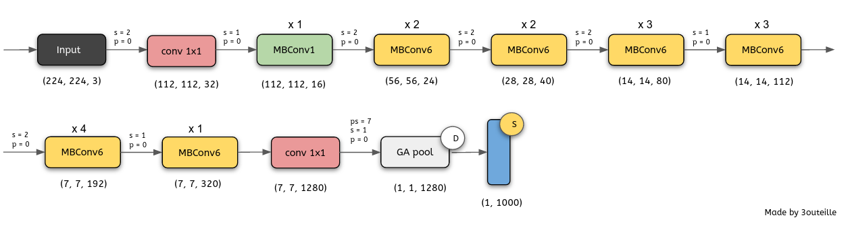
Algorithm / Methodology:
Convolutional Neural Network Model
Efficient Net:

Slide 14
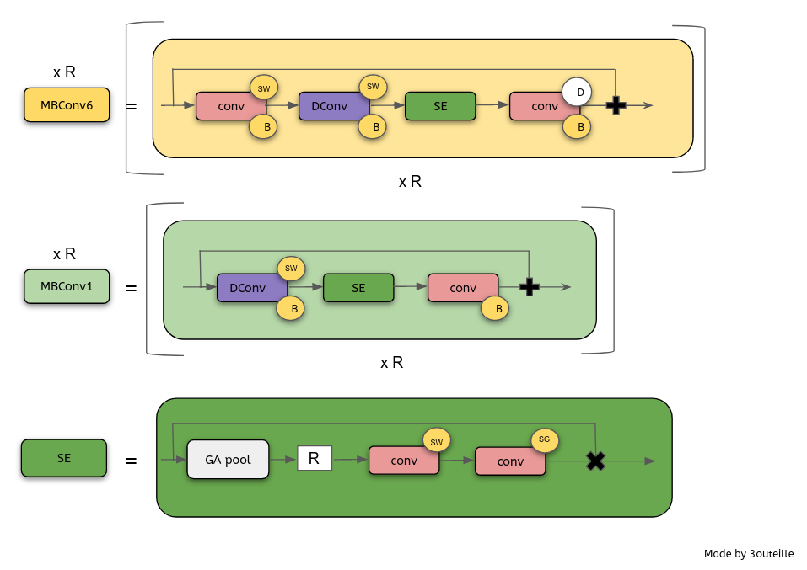
contd..
Blocks:

Slide 15
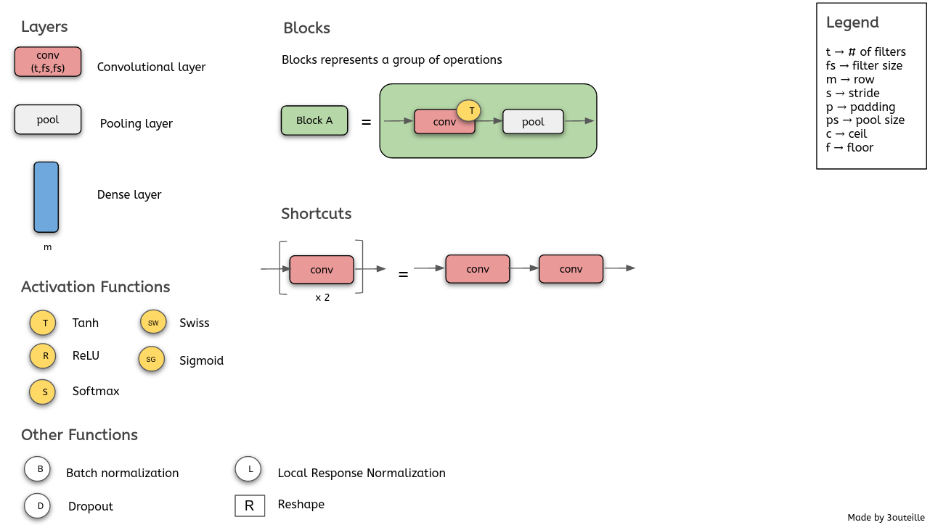
contd..

Slide 16
Classification-Adaboost:
Combine multiple weak classifiers into a single strong classifier.
Sequential Learning Process
It having Stumps
Weight assigning: W = 1/n where W-Weight,n-Number of Records
Total Error = No. of Incorrected classification / no. of records
Performance of stumps = ½ log ((1-TE)/TE)
Incorrectly classified records, New sample Weight = weight(old) x e^{p.o.f}
correctly classified records, New sample Weight = weight(old) x e^{-p.o.f}
Normalized Weight = Updated Weights/∑updated weights.

Slide 17
Performance Evolution :
Accuracy: (TP+TN)/(TP+FP+TN+FN)
Precision: TP/(TP+FP)
Recall : TP/(TP+FN)
F score: (2*Precision*Recall)/(Precision+Recall)
ROC curve: Draw a curve using, TP rate vs FP rate
TP rate = TP/TP+FN
FP rate = FP/TN+FP
Where TP-True Positive,
FP-False Positive,
TN-True Negative,
FN-False Negative,

Slide 18
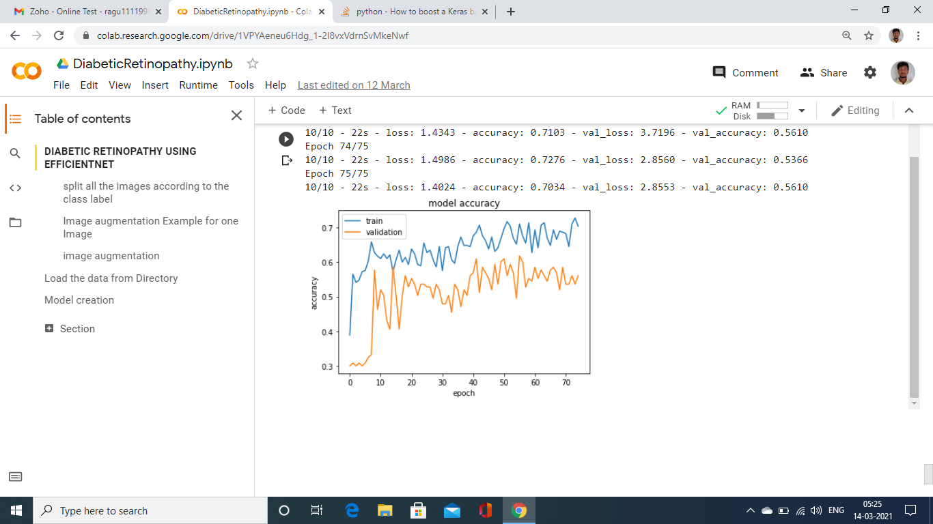
Output :

Slide 19
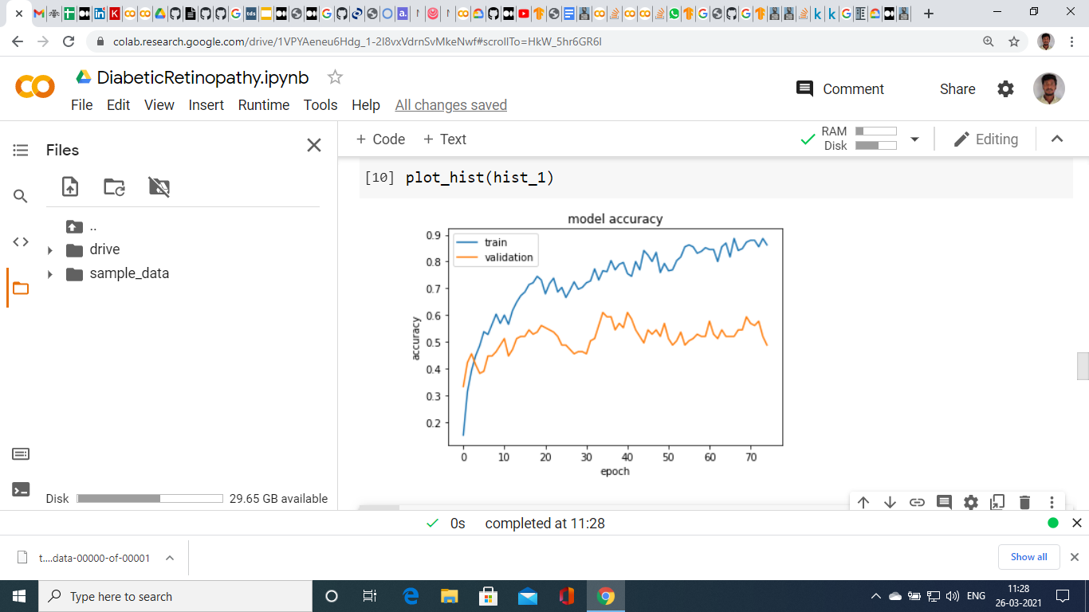

Slide 20
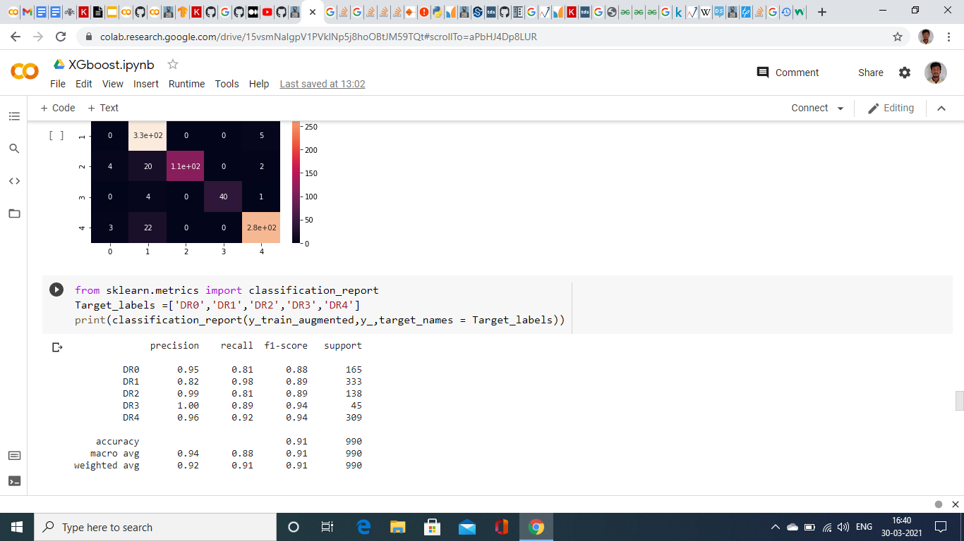

Slide 21
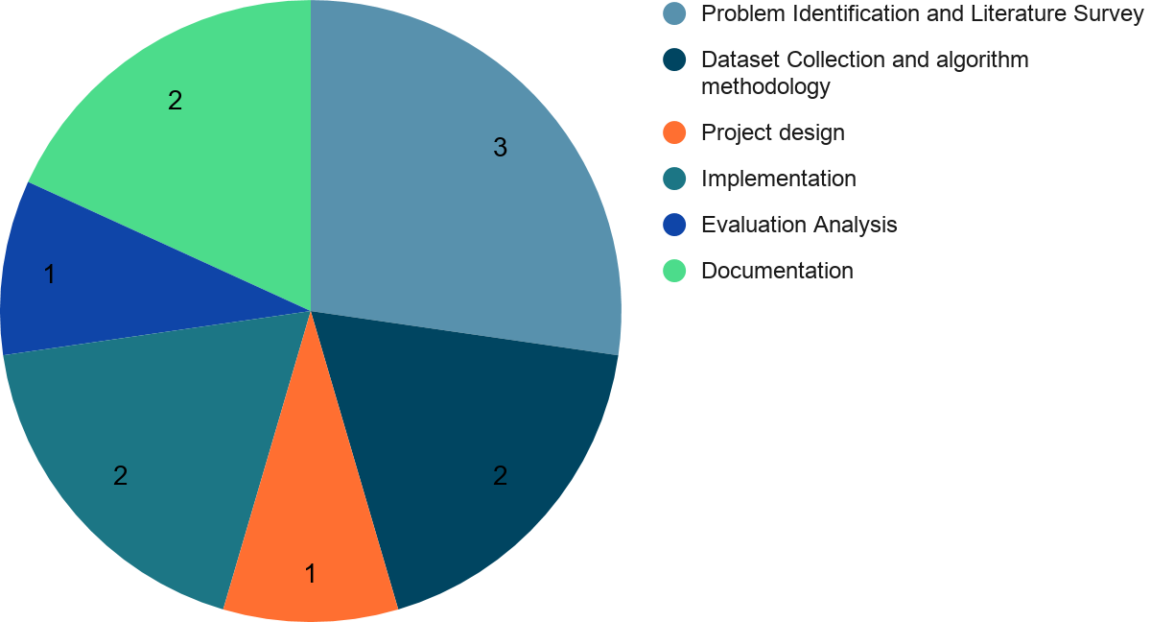
Project Planning:
Measured in Weeks

Slide 22
References :
1. M. Mateen, J. Wen ,N. Nasrullah, Song Sun and S. Hayat, “Exudate Detection for Diabetic Retinopathy Using Pretrained Convolutional Neural Networks”, Hindawi Complexity, vol. 2020, no.5801870, 2020.
2. E-Optha http:// www.adcis.net/en/Download-Third-Party/E-Ophtha.html.
3. DIARETDB1 http:// www.it.lut.ﬁ/project/imageret/diaretdb1/index.html.
4. B. Tymchenko , P. Marchenko and D. Spodarets, “Deep Learning Approach to Diabetic Retinopathy Detection”, arXiv ,vol. 2003, no.02261, 2020 .
5. Kaggle DRDC-2015 https:// www.kaggle.com/c/diabetic-retinopathy-detection/data
6. M. Ahtazaz Ahsan, Adnan Qayyum, Junaid Qadir and Adeel Razi, ”An Active Learning Method for Diabetic Retinopathy Classiﬁcation with Uncertainty Quantiﬁcation”, arXiv:
Vol . 2012, no. 13325 ,2020.
7. APTOS-2019 https:// www.kaggle.com/c/aptos2019-blindness-detection
8. EN. Parvathy and G. Bharadwaja kumar, “Diabetic Retinopathy Image Classification using Deep Neural Network”, Special issue on “Advances in Smart Computing and Bioinformatics”, Asian Journal of Pharmaceutical and Clinical Research, pp . 460 – 463, 2017.
9. Z. Gao, J. Li, J. Guo, Y. Chen, Z. Yi and J. Zhong, “Diagnosis of Diabetic Retinopathy Using Deep Neural Networks”, IEEEAccess, Vol. 7, pp. 3360 – 3370, 2019.
10. M. Mateen, J. Wen, Nasrullah, S. Song and Z. Huang, “Fundus Image Classification Using VGG-19 Architecture with PCA and SVD”, Symmetry, Vol. 11, no. 1, pp.1 – 12, 2019.
11. H. Riaz, J. Park, H. Choi, H. Kim and J. Kim, “Deep and Densely Connected Networks for Classification of Diabetic Retinopathy”, Special Issue in Artificial Intelligence in Diagnostics, Diagnostics, Vol. 10, no.1, pp. 1- 15, 2020.
12. S. Gayathri, V.P Gopi and P. Palanisamy,” A Lightweight CNN for Diabetic Retinopathy Classification from Fundus Images”, Biomedical Signal Processing and Control, Vol. 62, no. 102115, pp.1 – 12, 2020.
13. M. Tan and Q. V. Le, “EfficientNet: Rethinking Model Scaling for Convolutional Neural Networks”,International Conference on Machine Learning, pp.10691-10700,2019.2019
14. S. Mark, H. Andrew, Z. Menglong, Z. Andrey, and C. Liang-Chieh, “Mobilenetv2: Inverted Residuals and Linear Bottlenecks'', The IEEE Conference on Computer Vision and Pattern Recognition’2018, pp. 4510–4520, 2018.

Slide 23
THANK YOU

